Slide 1
Filtering (I)
Dr. Chang Shu
COMP 4900C
Winter 2008

Slide 2
Agenda
Getting to know images.
Image noise.
Image filters.

Slide 3
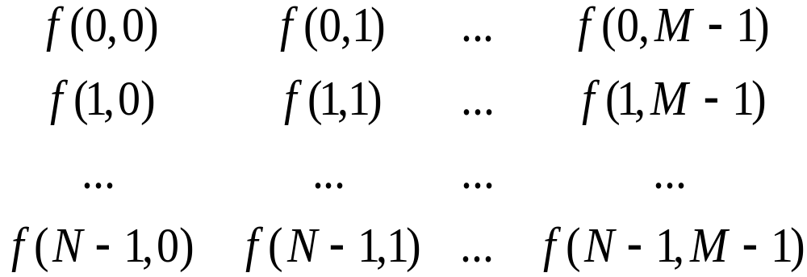
Digital Images
An image - rectangular array of integers
Each integer - the brightness or darkness of the image at that point
N: # of rows, M: # of columns, Q: # of gray levels
  Q = 2^{q} (q is the # of bits/pixel)
  Storage requirements: NxMxq
  (e.g., for N=M=1024 and q=8 → storage = 1MB)

Slide 4
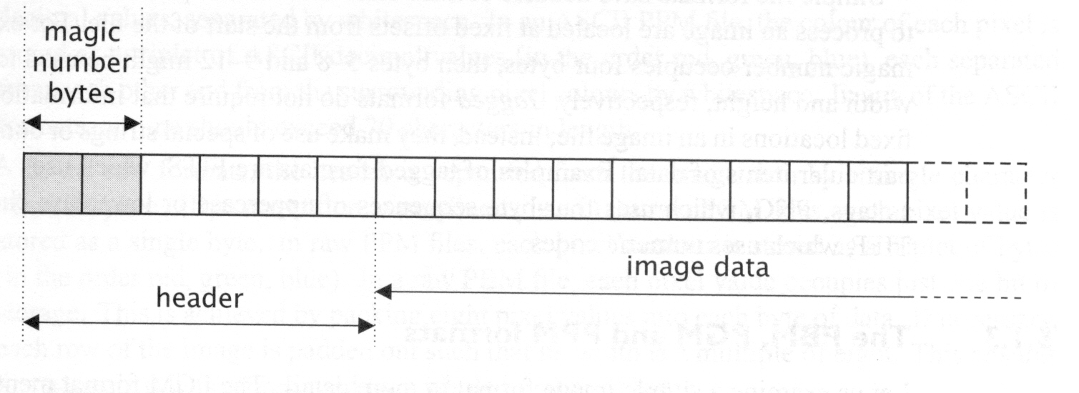
Image File Formats
Header – usually contains width, height, bit depth.
Magic number – identify file format.
Image data – stores pixel values line by line without breaks.

Slide 5
Common Image File Formats
GIF (Graphic Interchange Format, .gif)
PNG (Portable Network Graphics, .png)
JPEG (Joint Photographic Experts Group, .jpeg)
TIFF (Tagged Image File Format, tiff)
PGM (Portable Gray Map, .pgm)
FITS (Flexible Image Transport System, .fits)
…

Slide 6
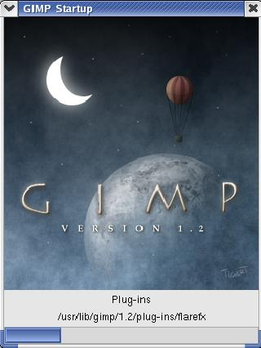

Image Manipulation Tools
Linux: xv, gimp
Windows: Photoshop, Paint Shop Pro

Slide 7
OpenCV + Ch – read and display images
#ifdef _CH_
#pragma package <opencv>
#endif
#include "cv.h"
#include "highgui.h"
// Load the source image. HighGUI use.
IplImage *image = 0, *gray = 0;
int main( int argc, char** argv )
{
char* filename = argc == 2 ? argv[1] : (char*)"fruits.jpg";
if( (image = cvLoadImage( filename, 1)) == 0 )
return -1;
// Convert to grayscale
gray = cvCreateImage(cvSize(image->width,image->height), IPL_DEPTH_8U, 1);
cvCvtColor(image, gray, CV_BGR2GRAY);
// Create windows.
cvNamedWindow("Source", 1);
cvNamedWindow("Result", 1);
// Show the images.
cvShowImage("Source", image);
cvShowImage("Result", gray);
// Wait for a key stroke
cvWaitKey(0);
cvReleaseImage(&image);
cvReleaseImage(&gray);
cvDestroyWindow("Source");
cvDestroyWindow("Result");
return 0;
}

Slide 8
Noise
Noise in Computer Vision:
  Any entity (in images, data, or intermediate results) that is not interesting for the main computation
Can think of noise in several contexts:
  Spurious pixel fluctuations, introduced by image acquisition
  Numerical inaccuracies, introduced by the computer’s limited precision, round-offs or truncations, etc
  Entities that do not belong to any meaningful region (edges that do not correspond to actual object contours)

Slide 9
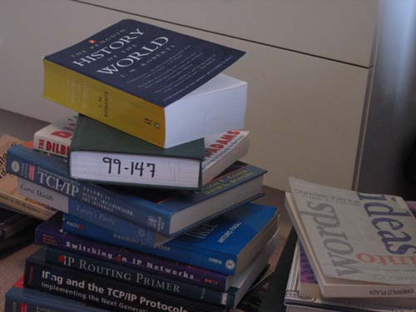

Image Noise

Slide 10

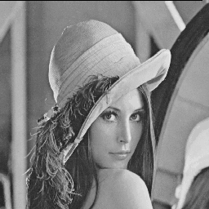
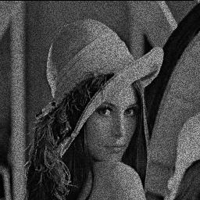
Image Noise
Additive and random noise:
I(x,y) : the true pixel values
n(x,y) : the (random) noise at pixel (x,y)
➔

Slide 11
Random Variables
A random variable is a variable whose values are determined by
the outcome of a random experiment.
A random variable can be discrete or continuous.
Examples
A coin is tossed ten times. The random variable X is the number of tails that are noted. X can only take the values 0, 1, ..., 10, so X is a discrete random variable.
A light bulb is burned until it burns out. The random variable Y is its lifetime in hours. Y can take any positive real value, so Y is a continuous random variable.

Slide 12
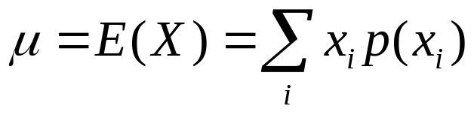
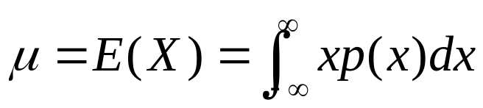
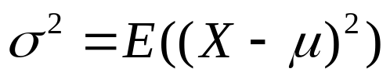
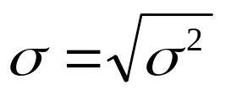
Mean, Variance of Random Variable
Mean (Expected Value)
(discrete)
(continuous)
Variance
is called standard deviation

Slide 13
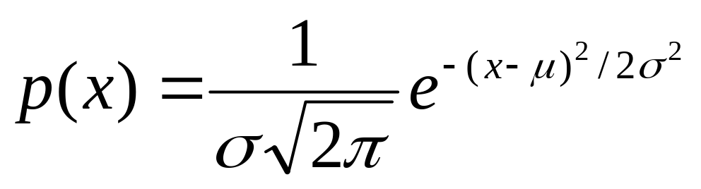
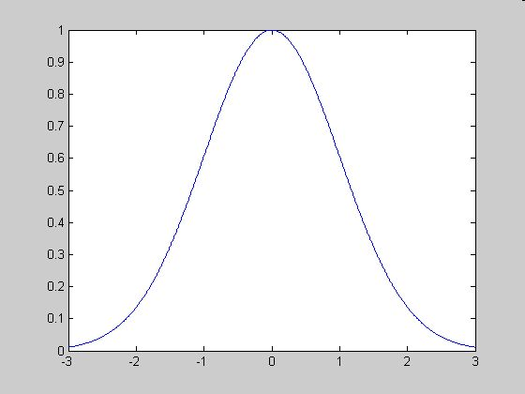
Gaussian Distribution
Single variable

Slide 14

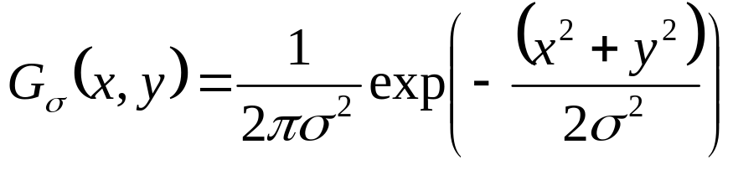
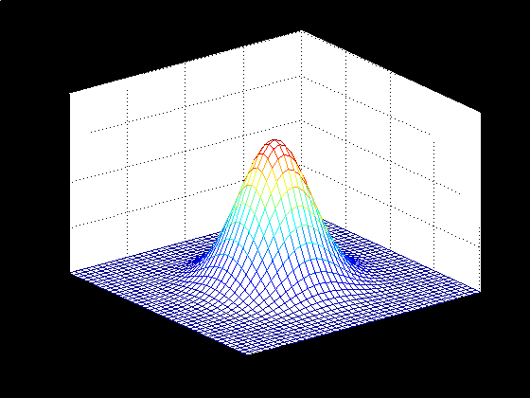
Gaussian Distribution
Bivariate with zero-means and variance

Slide 15
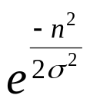
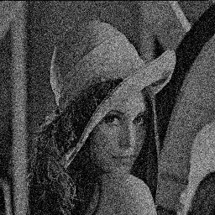
Gaussian Noise
  Is used to model additive random noise
The probability of n(x,y) is
Each has zero mean
The noise at each pixel is independent

Slide 16
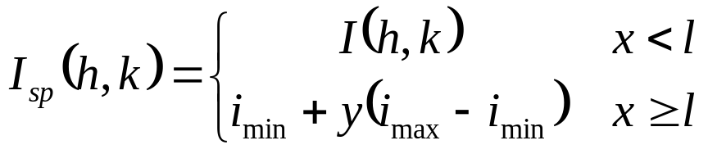
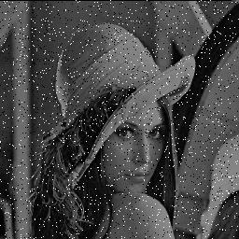
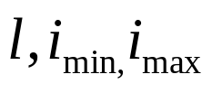
Impulsive Noise
  Alters random pixels
  Makes their values very different from the true ones
Salt-and-Pepper Noise:
  Is used to model impulsive noise
x, y are uniformly distributed random variables
are constants

